Slide 1
Go to Google Image Search &
search “Autodesk Maya”
& “Maya Polygons”
Visit our “3d Perspective” webpage.
Open project file from webpage!
Click on links & read
(Polygons & Nurbs 1st)
Day 1/8

Slide 2
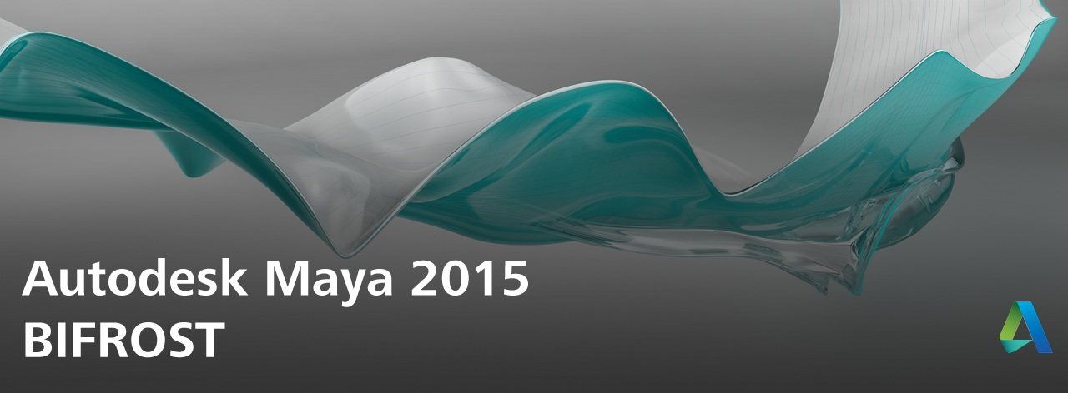

Slide 3
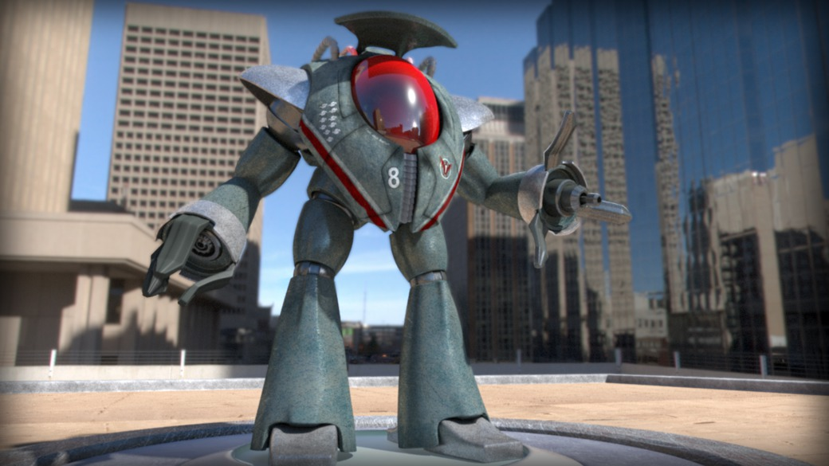
What is Maya?
It’s an awesome 3d modeling & animation program!

Slide 4
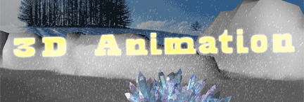
YES you can make full 3d Hi-res
animated films in Maya!
Here’s a short little
Maya .gif by Mr. Nourse btw☺.
(Play Slideshow to see it! Press F5!)

Slide 5
What are polygons & NURBS?

Slide 6
What are polygons?
What are the basic components of polygons?
Vertices, edges, faces
What’s it called when many faces are connected together?
a network of faces called a mesh
We create 3d polygonal models using polygon meshes &
attach textures or images to them.
What are Meshes?
What are faces?
What are edges?
What are vertices? Basically 3d ankerpoints

Slide 7
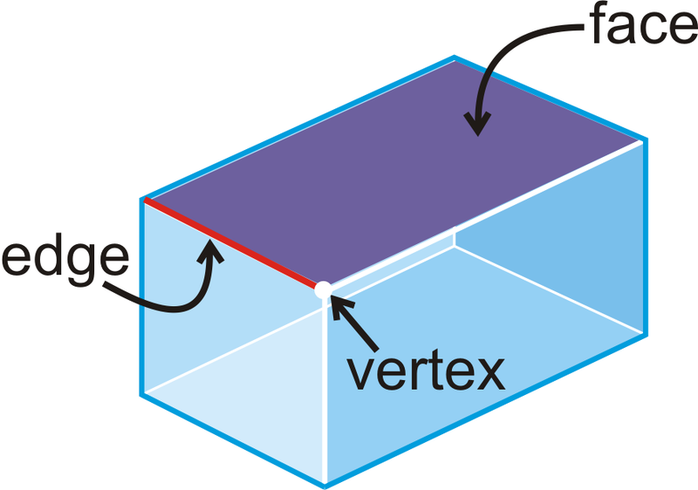

Slide 8
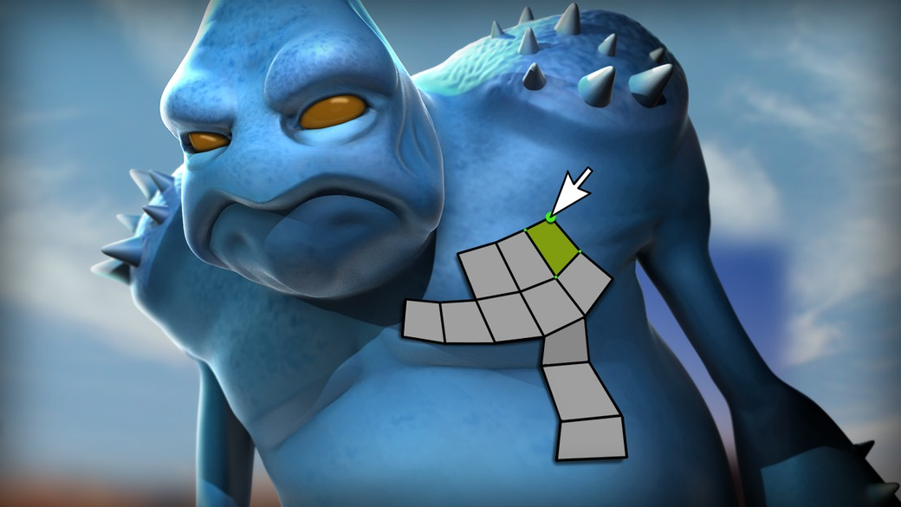
What’s a mesh?
Wireframe of polygons

Slide 9
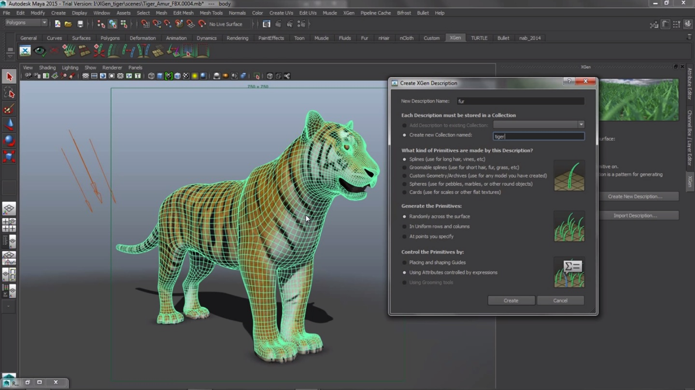
Meshes are what polygons are made of.
Meshes are what polygons are made of.

Slide 10
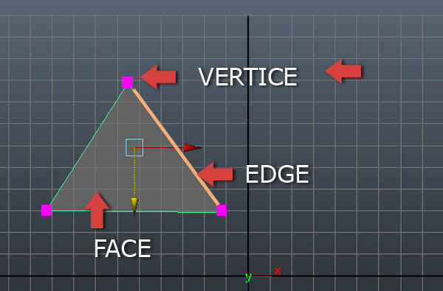
Here are the 3 parts of a polygon.
Memorize them NOW!!

Slide 11
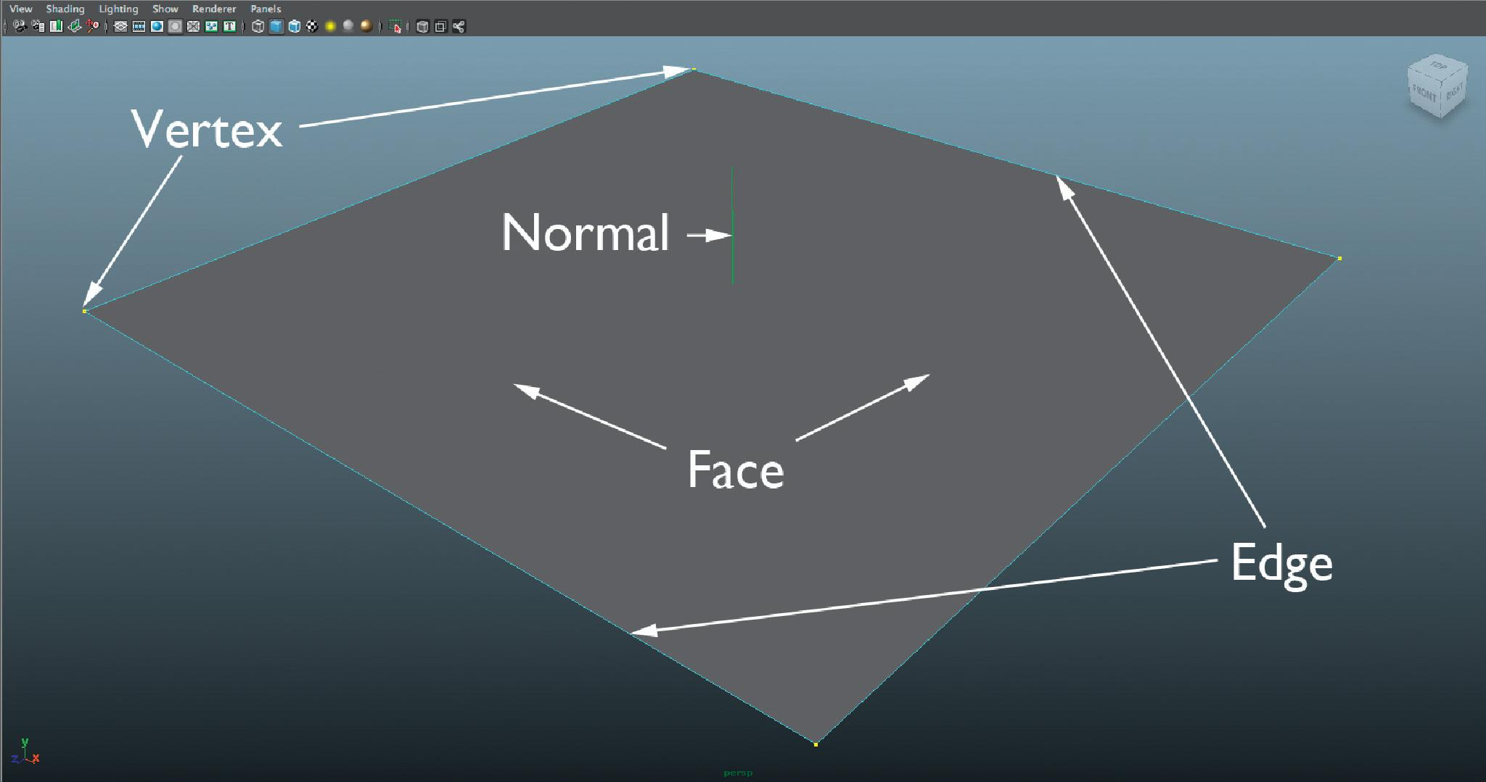
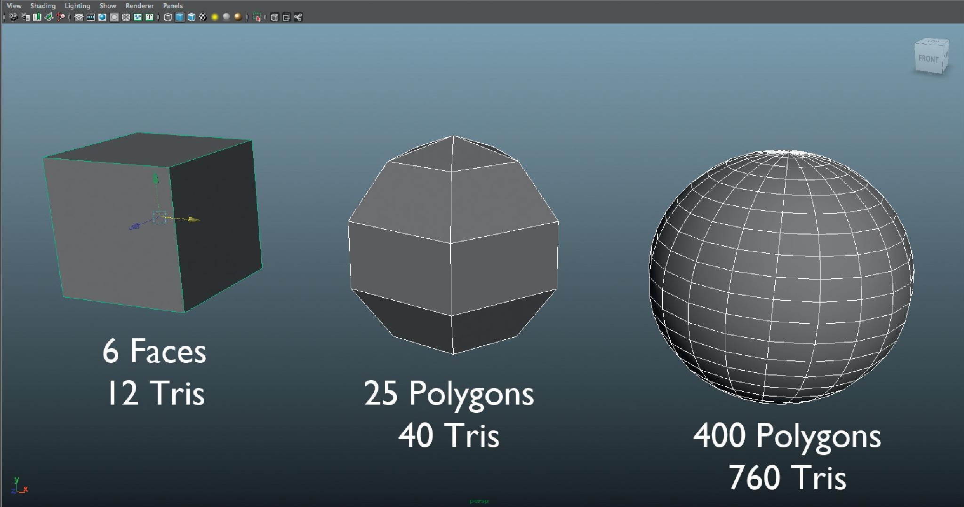
Polygons

Slide 12
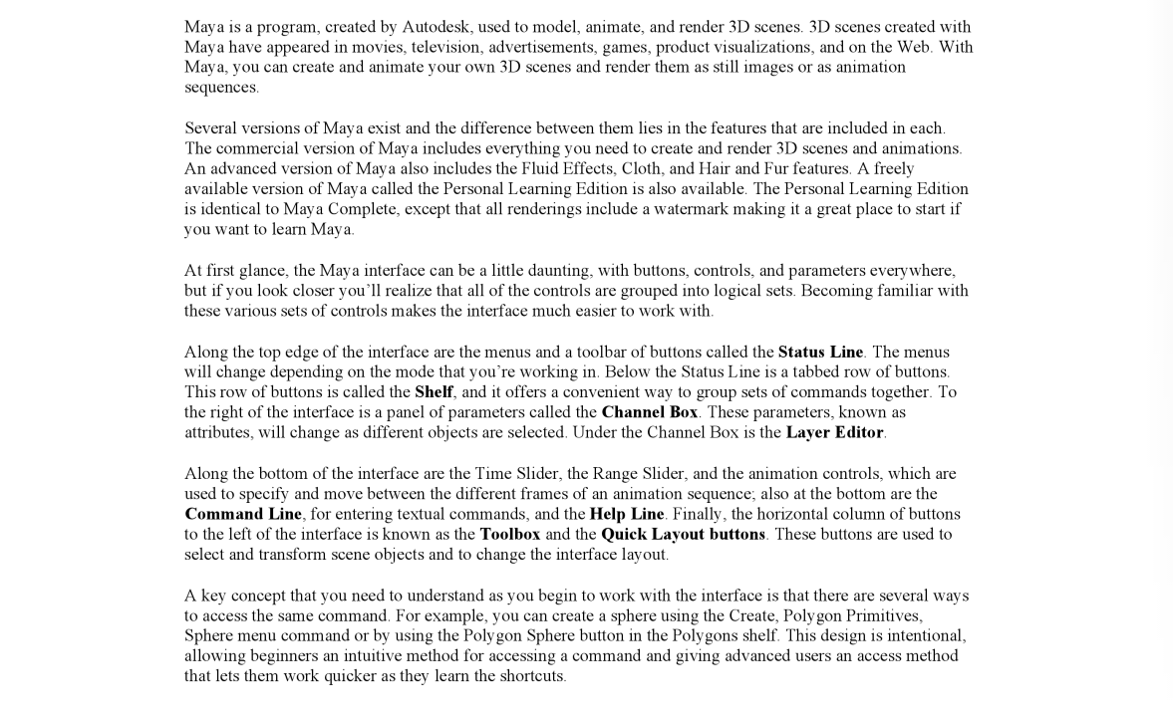
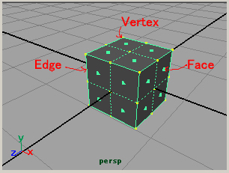
Autodesk Maya 2015 Basics Guide

Slide 13
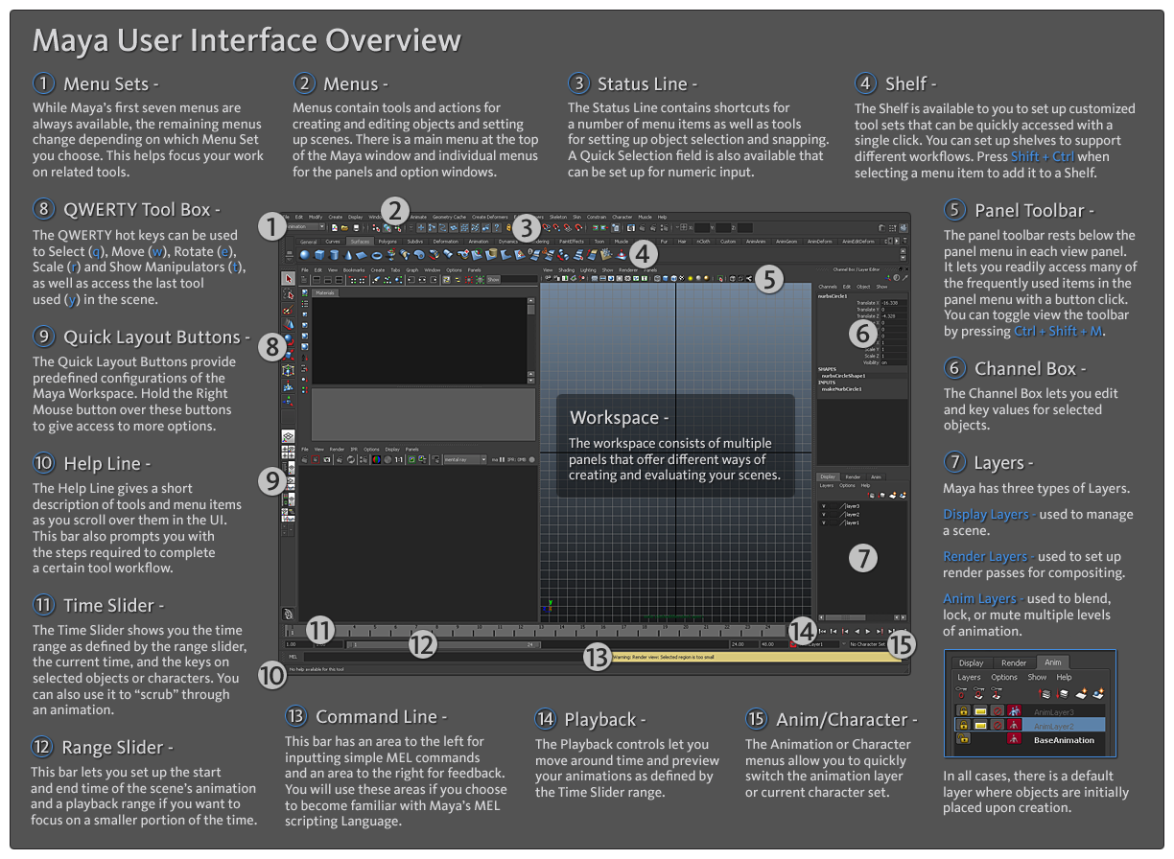
What is 3d?

Slide 14
You should know where these panels exists and what they do. These are the main 7 we’ll be using.
1 - Menu Sets
6 - Channel Box
7 - Layers
8 - QWERTY
9 - Quick Layout Buttons
11 - Time Slider
14 - Playback panel
Use the previous slide to help you!

Slide 18
Open Autodesk Maya &
watch all 6 intro videos!
You should know how to:
View wireframe & shaded modes (4 & 5)
Use F & Zoom, pan, & roll cam views
Move objects, view from top, front, side= spacebar
Move, rotate, & scale w xyz & what object mode
is & how to select faces & multiple faces
5.Channel box, Transform, Extrude, & Split tool

Slide 20
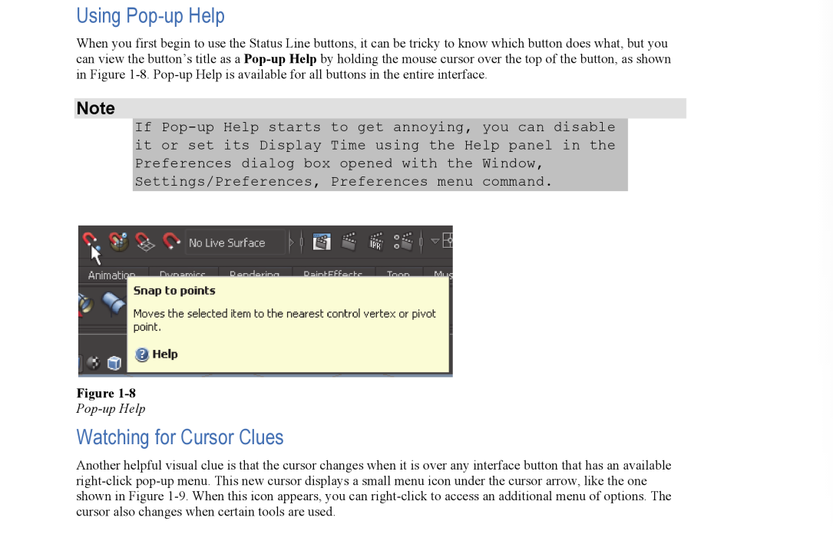

Slide 21
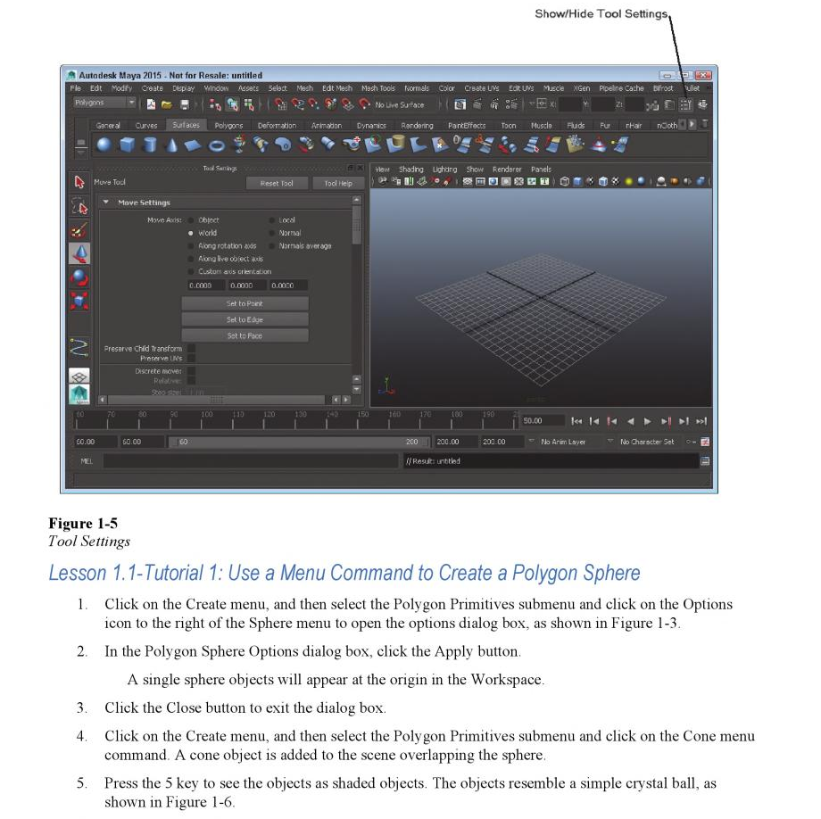

Slide 22
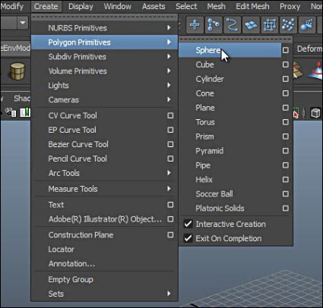
Create the 1st 10 polygons below, move
them on the grid, and transform
them in some way (size, scale, or rotate).

Slide 23
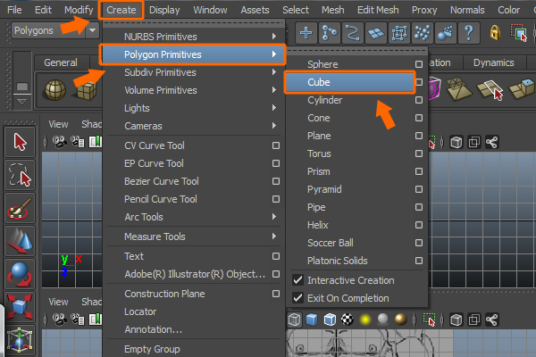
Create all Polygon Primitives, move
them on the grid, and transform
them in some way (size, scale, rotate, or sculpt).

Slide 24
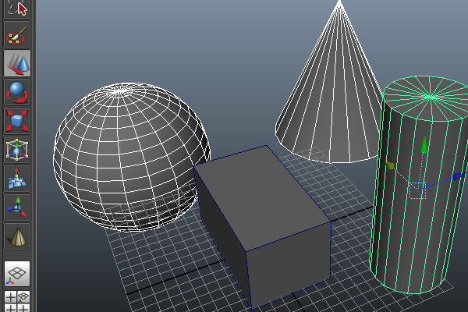

Slide 25
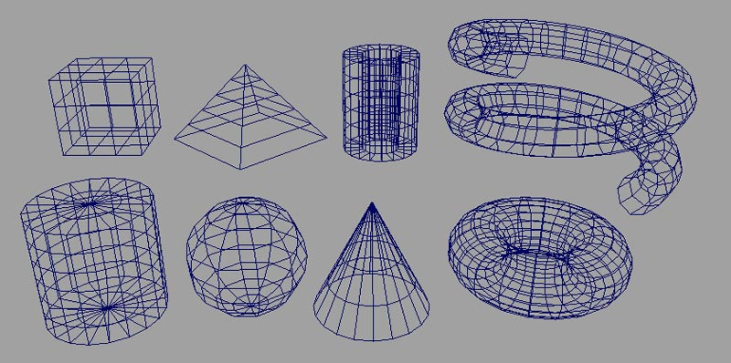

Slide 26
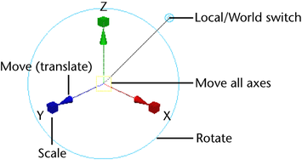

Slide 27
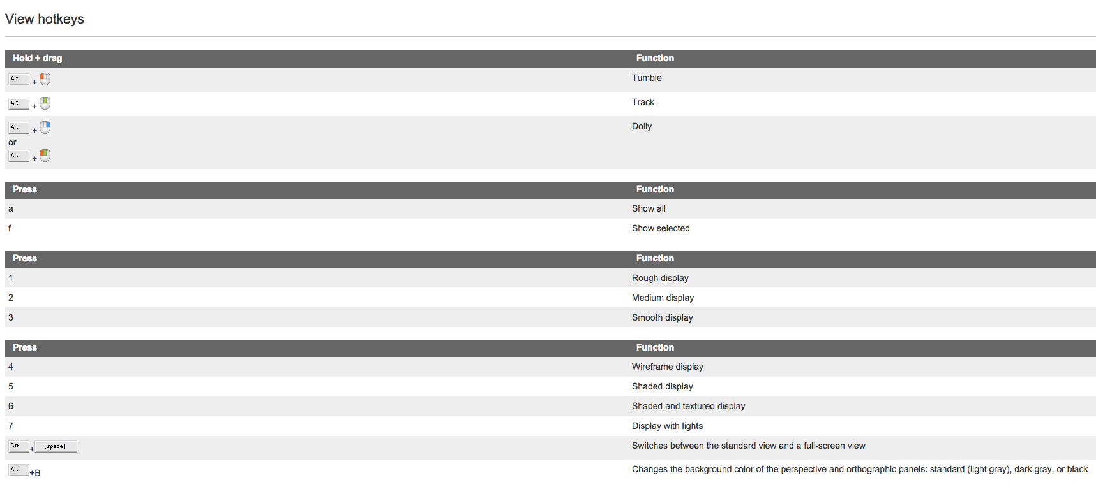
What hotkeys to use?
USE THESE! Memorize these!

Slide 28
Use these keys especially!
They will speed up your work flow
and make everything run smoother.

Slide 29
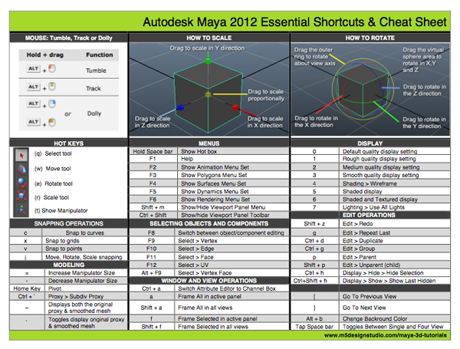

Slide 31
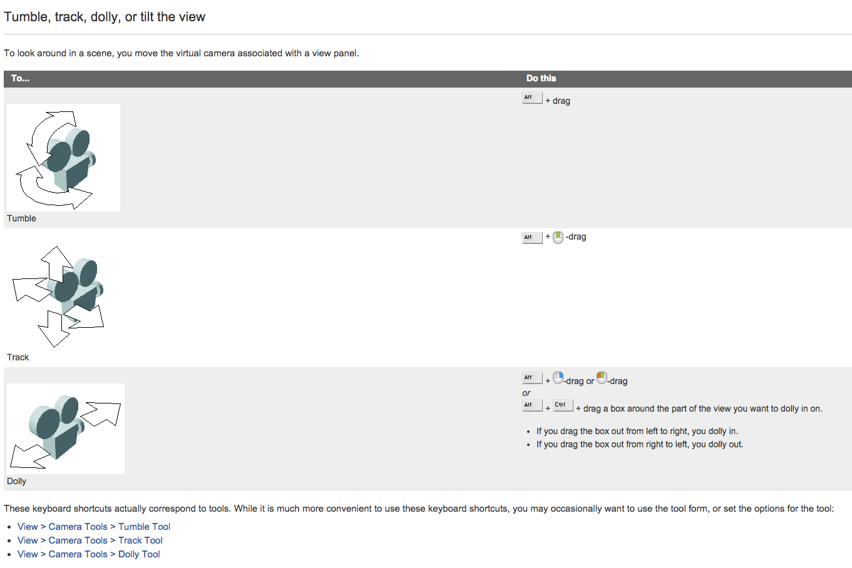

Slide 32
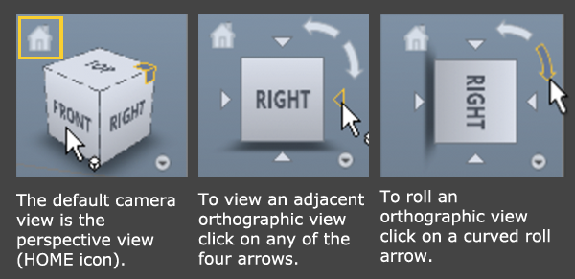

Slide 33
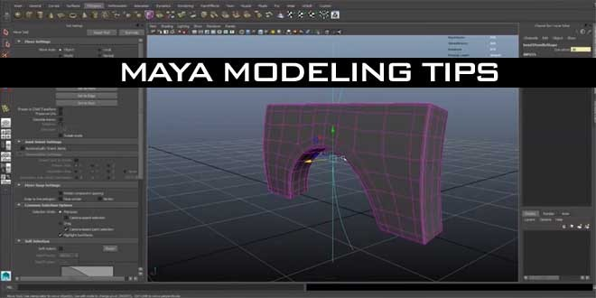
What is modeling?
The manipulation & combination of objects.

Slide 34
How to Model?
Know the differences
of modes,
techniques,
and tools.

Slide 35
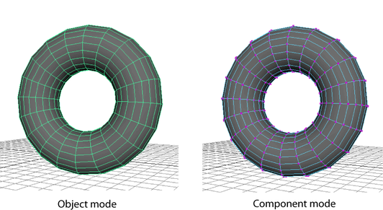
Objects and components
In Maya, you model, animate, and render using objects such as spheres, NURBS surfaces, polysets, and so on. Objects are made up of or contain components, such as control points, patches, polygon faces, and so on.

Slide 36
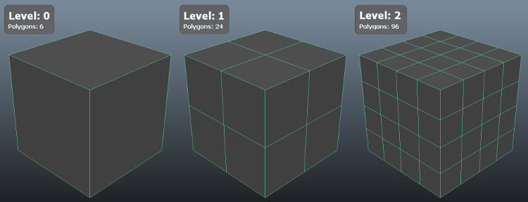
What is Subdividing?
Dividing the meshes into more polygons.

Slide 37
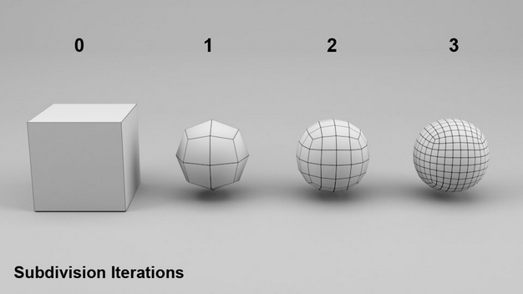
Why Subdivide?
The more divisions a mesh has the smoother the curves becomes. In order to sculpt an object it should be subdivided first.

Slide 38
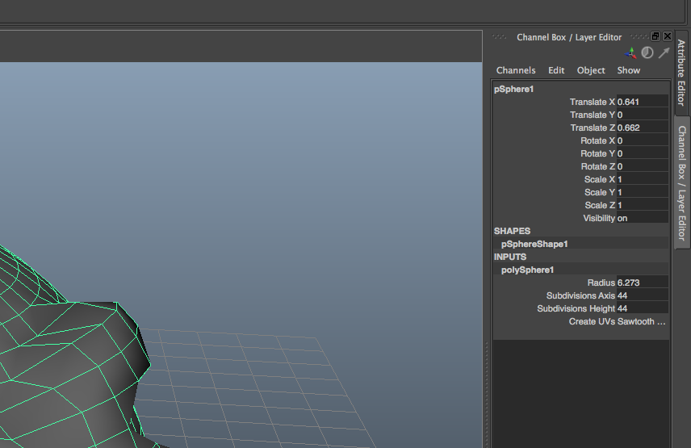
How to subdivide an object like a sphere?
1
Go to Channel Box tab, click on “polySphere…..” under SHAPES, and
type in a higher number for both “Subdivisions”.

Slide 39
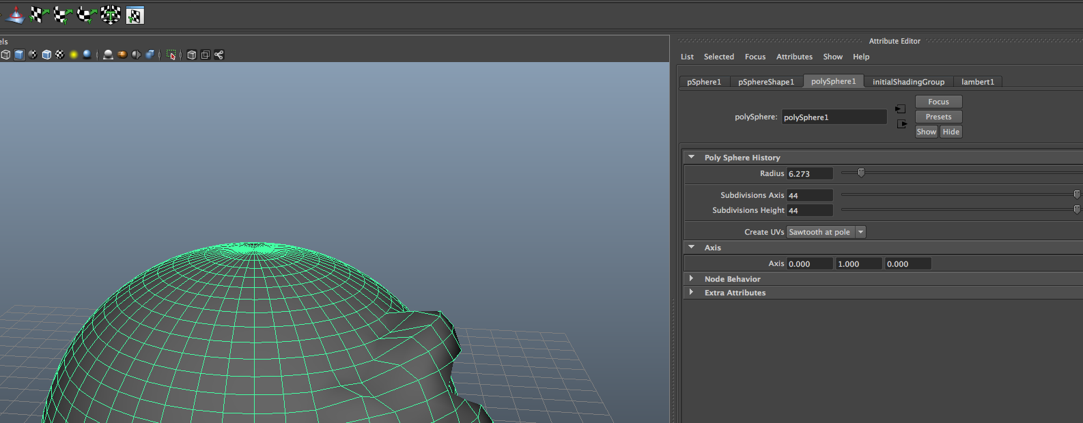
If subdivisions don’t appear in Channel Box
Go to Attribute Editor
which is located on the
top right of Maya.

Slide 40
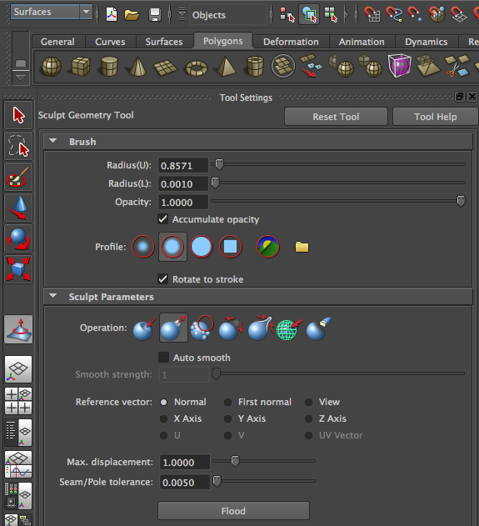
What is Sculpting?
Exactly what it sounds like☺

Slide 41
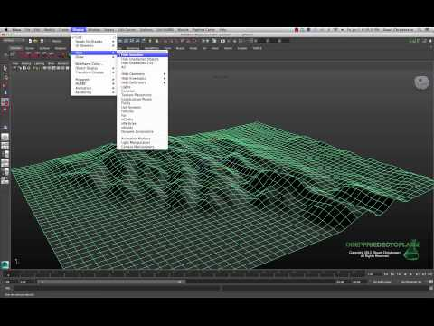
What is Sculpting?
This is a plane sculpted.

Slide 42
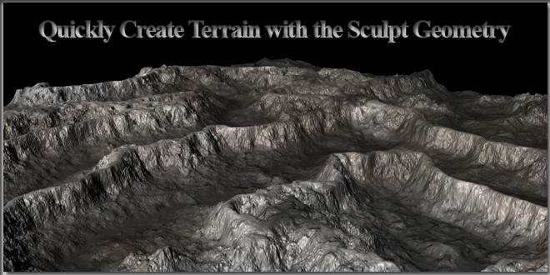
What is Sculpting?
This is after the sculpted mesh
has texture and has been rendered.

Slide 43
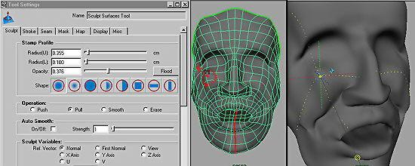
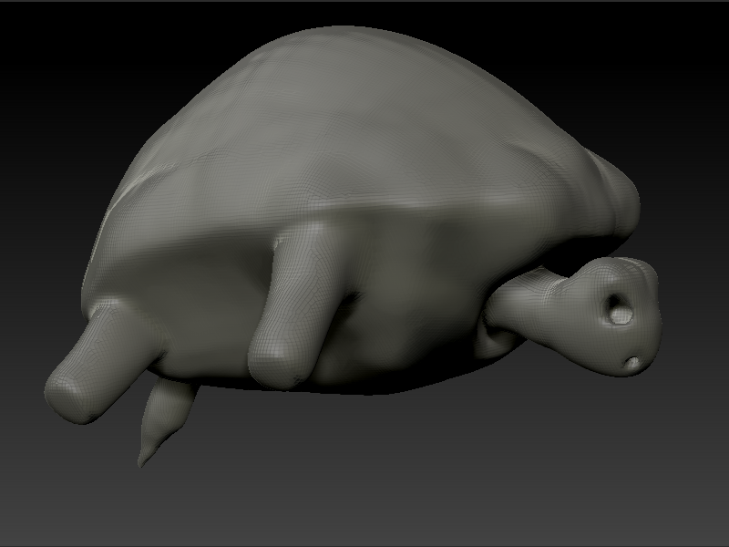
Sculpted objects here.

Slide 44
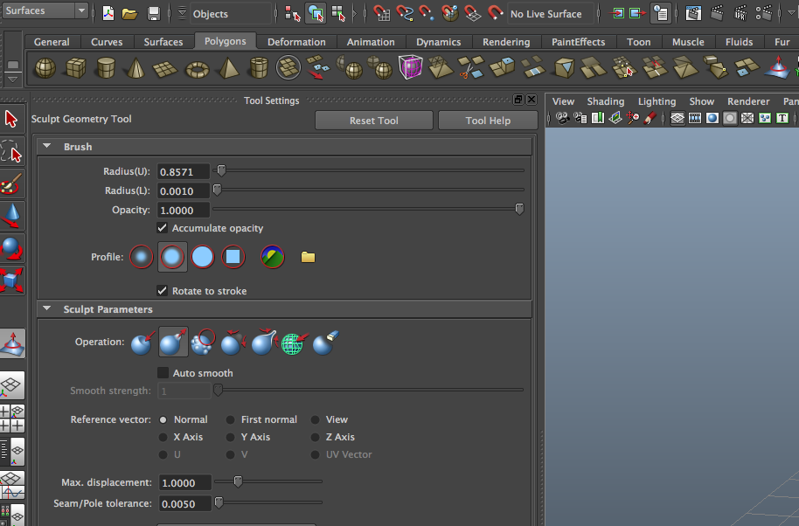
How to Sculpt?
Find this tool, use Radius, Operation, and
Max displacement mostly to sculpt!

Slide 45
Modeling Day(2)
Go to Google Image Search &
search “Maya Soft Select” & “Maya Extruding”
Visit our “3d” webpage & Download project file again!
While waiting click on all the
links on webpage under “Day2 “ &
read about them such as below:
Duplicating
Combining
Polygon Components
Soft Selection
Extruding faces, edges, or vertices
Create these 4 Polygons in preparation for the warmup:
Cube, Cylinder, Torus, Helix
Day 2/8

Slide 46
Objects and components
In Maya, you model, animate, and render using objects such as spheres, NURBS surfaces, polysets, and so on. Objects are made up of or contain components, such as control points, patches, polygon faces, and so on.

Slide 47
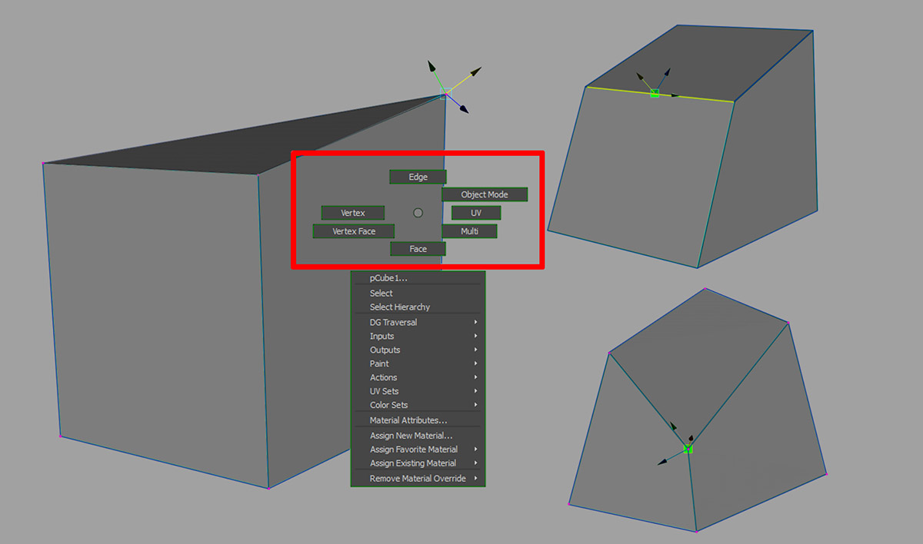
Right click a polygon to get these menus

Slide 48
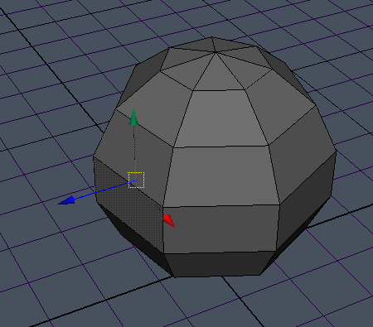
You can select faces and
use move tool to move them.

Slide 49
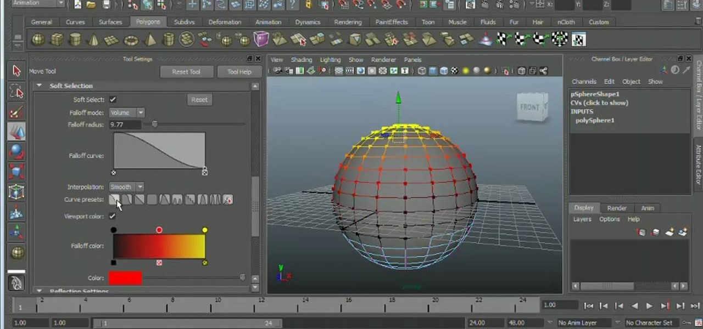
What is Soft Selection?
It’s basically morphing!
Where is Soft Selection? Tool Settings
Use the MOVE tool.

Slide 50
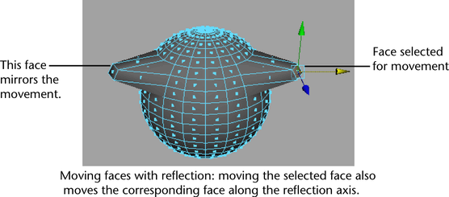
Reflection mode is located
in Tool Settings Panel

Slide 51
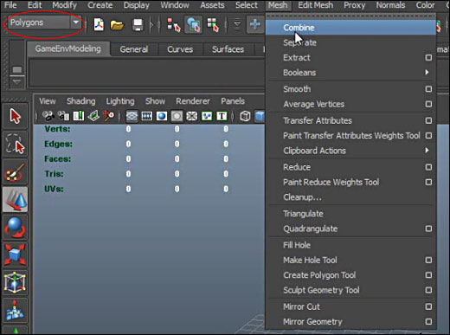
How to duplicate objects? Cmd+D then move it!
How to Combine objects?
1st make sure you’re in the Polygon menu.
Shift select 2 or more polygons touching and
go to the menu bar and select MESH, COMBINE.

Slide 52
How to Separate objects?
Look closely up there!

Slide 53
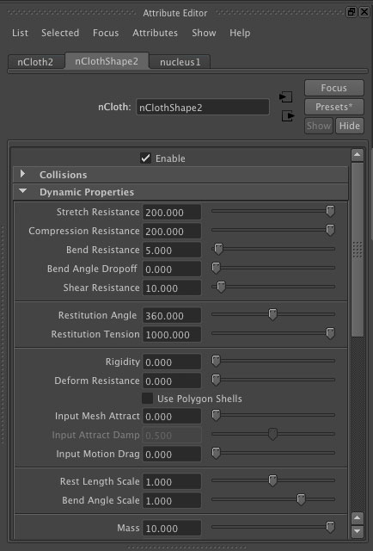
What is the Attribute Editor?

Slide 54
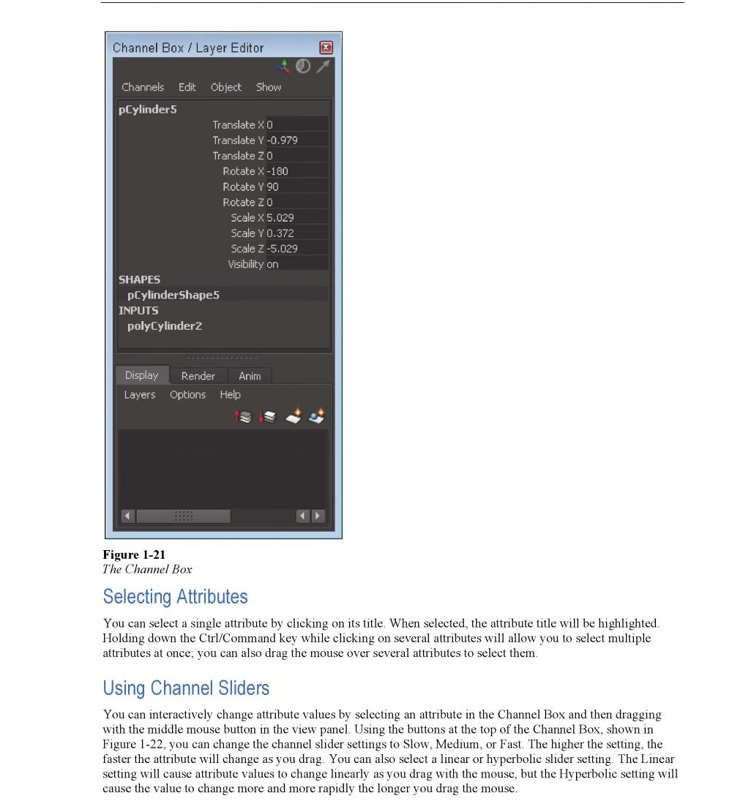

Slide 55
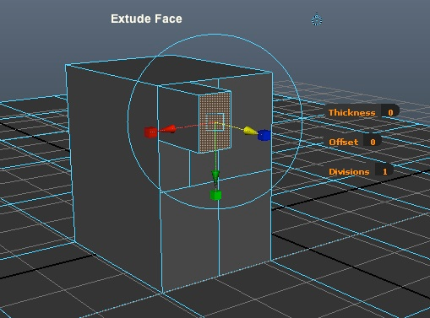
What is Extrude?

Slide 56
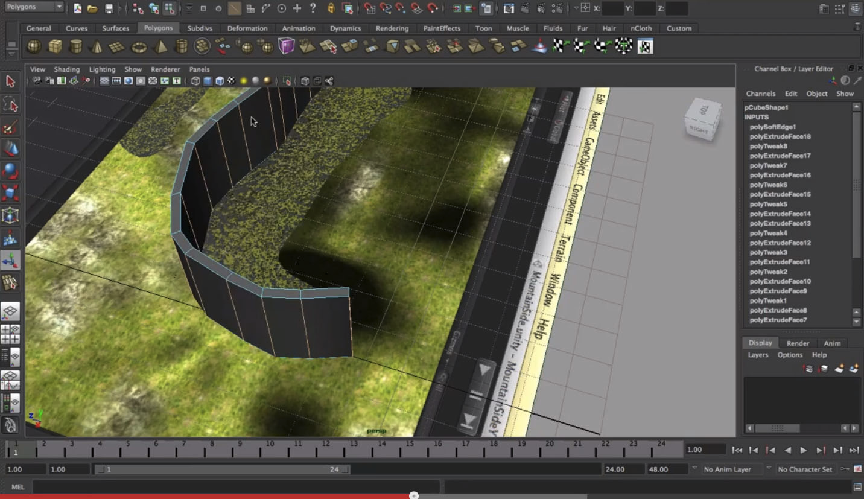
How to Extrude?
Pull out or push in!

Slide 57
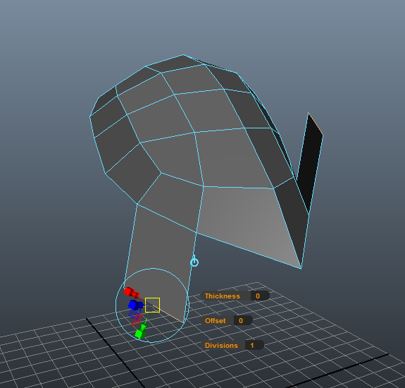
What does Extrude look like?

Slide 58
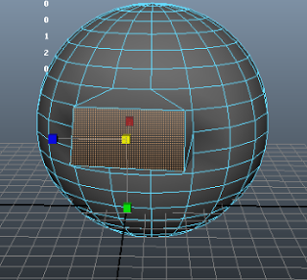

Slide 59
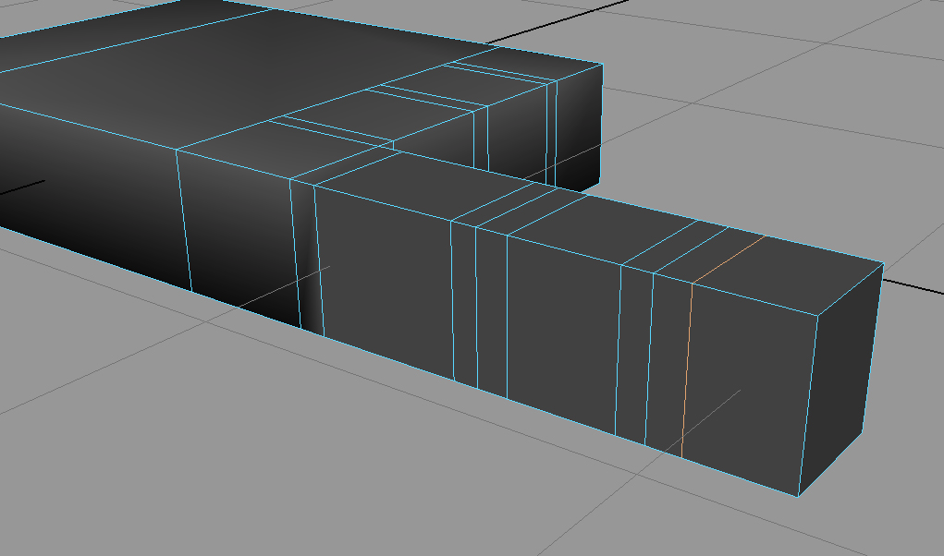

Slide 60
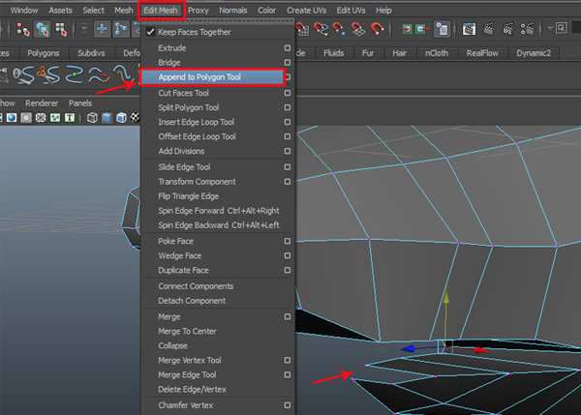
How to Extrude with the Tool?

Slide 61
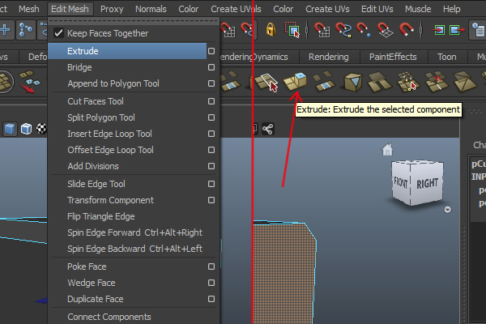
Where is Extrude?

Slide 62
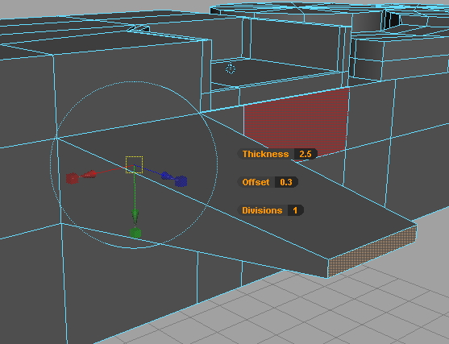
How to Extrude?
Hover and drag!

Slide 63
How to Extrude with the Tool?

Slide 65
How to Split a polygon?

Slide 67
How to bend a polygon?
Select object in Object mode
Set menu to Animation
Go to “Create Deformers, Nonlinear, Choose BEND
Go to Attribute Editor & select Bend tab
Adjust low, high, & curvature
Duplicate after bending & delete deformer & original

Slide 68
How to Twist?
Use a Helix? No!
Use Deformers!

Slide 69
How to twist a polygon?
Select object in Object mode
Set menu to Animation
Go to “Create Deformers, Nonlinear, Choose BEND
Go to Attribute Editor & select Bend tab
Adjust low, high, & curvature

Slide 70
Fill a gap or hole
Go to Edit Mesh,
Append to Polygon Tool
Or select edges

Slide 71
How to revolve around a line?

Slide 72
What is CV vs EP Curve Tools?

Slide 73
What is CV Curve Tools?
Use it to create a vase.

Slide 74
How to revolve around a line?
Go to Create, CV Curve Tool
From side or front view create a line
Select Selection tool (turns line green)
Select SURFACES menu
Select SURFACES, REVOLVE or
go to menu by clicking on rectangle

Slide 75
To create a vase or chess piece.
Put menu on Surface
Go to Create, CV Curve tool
Go to FRONT view
Start on center of X/Y
Go to Surfaces & Revolve
Hit 3

Slide 76
Texturing Day(3)
Go to Google Image Search & search “Maya Painting Effects”
Visit our “3d Perspective” webpage.
Download project file from webpage!
Click on links ,”Painting Effects” & read
Open Mudbox & watch 1st 4 vids!
Paint, sculpt, & submit!
Open Maya add new Materials!
Send it to Mudbox (20 mins)
3d Paint in Maya on object & grid.
Day 3/8

Slide 77
How to add colors, textures, or images?

Slide 79
How to add colors, textures, or images?
Right click, Assign New Material.
Choose “Mia_Material”
Go to Rendering Settings Panel & change Settings
to Mental Ray
Change Color
Add Light (spotlight – change cone size, intensity,
& direction)
Rendering Settings Panel – click on little render
frame button

Slide 84
What Mental Ray? Super sweet textures!
Right click on an object in Object mode
Choose Assign Material
Choose Mia_Material
Go to Attribute Editor Panel
Click on “Mia” tab
Click on Presets
Go to Render Settings and choose Mental Ray!
You may have to add a light & render out a frame to test material.

Slide 85
What are nodes?

Slide 86
What are nodes?

Slide 87
How to 3d paint trees?
Use the Painting Effects Tool!

Slide 88
Lighting, Cams, Layers! (Day 4)
Visit our “3d Perspective” webpage.
Click on all Day 4 links and read
Today we’ll create lights, cams,
& layers
Day 4/8

Slide 91
Animating Day 5
Visit our “3d Perspective” webpage.
Click on links under ”Day 5” &
read all!
Open project file & go through
“Day 5” slides
Everyone animates today!
Day 5/8

Slide 92
Animating Cam
Go to Create Cam
Move cam in desired direction
View inside cam by going to “Panels”
and changing it to “Cam1”
4. Select cam
5. Select Frame to start tween & press S
6. Select last frame of tween span
7. Move cam & press S
Day 5/8

Slide 93
Animating Cam on Motion Path
Go to Create CV Tool
View from TOP
Create path
Create cam & place on path
Shift select both
Go to Animation Menu
Click 2nd button = Attach Motion to Path
Go to Attribute editor = MotionPath tab!
(front axis Z, check Inverse Front, Cam Aim is option)
Day 5/8

Slide 94
Character
Go to Google & Search for
“Maya Rigging, Binding, Animating”
Visit our “3d Perspective” webpage
& click on all the links for character
development & animation.
Day 5/8

Slide 95
Dynamics – Day 6
Visit our “3d Perspective” webpage.
Click on links under ,”Dynamics”
Read all 8 closely!
Prepare for a quiz on info.
Day 6/8

Slide 96
Dynamic Demo
Go to Dynmaics, Effects
Create Fireworks
Drag playhead
Choose a frame to render &
click on clapper (Render frame) button
Day 6/8

Slide 99
Rendering
Visit our “3d Perspective” webpage.
Check out both links under Rendering.
In order to render out a hi-res version
you must render out a .jpg sequence
and import them into After Effects.
Click on the link on the webpage
for instructions.
Day 8/8

Slide 100
EXTRA
stuff
in Maya!

Slide 101
Hold down space bar for menu

Slide 102
Duplicate Special!

Slide 103
Duplicate along curve?

Slide 104
What is wave in Maya?

Slide 105
How to WAVE in Maya?
1. Wave – nonlinear deformers
2. Subdivide approx 150
3. Create deformer, WAVE
4. Amplitude approx .035
5. Set Wavelength approx .2
Offset, drop off, radius x 2

Slide 106
What is piping?

Slide 107
What is UV mapping?

Slide 108
How to UV Map?

Slide 109
What is UV mapping?

Slide 110
What is UV mapping?

Slide 111
How to UV map?

Slide 112
What is UV mapping?

Slide 115
To fill a hole or gap go to:
Edit Mesh,
& Append to Polygon Tool = fill!

Slide 116
Shatter technique
Edit Mesh,
& Append to Polygon Tool = fill!

Slide 117
Shatter Technique
Create object
Edit, delete by type- history
Modify, freeze transformations
Go to Dynamics menu
Effects, create Shatter
Solid shatter- choose amount
(jagginess 7 shards)
Sometimes it duplicates so pull out duplicate & delete

Slide 118
Sphere on fire
Create a Sphere
Go to Menu set “Dynamics”, Dynamics tab
Go to EFFECTS, Create Fire!
Go to next slide

Slide 119
Sphere on fire
Now press play or drag the playhead on the timeline.
You’ll see the fire effect in preview mode. You must
Render a frame to see what it really looks like. Next!

Slide 120
Sphere on fire
Click on the render frame button!

Slide 121
Clothing (end of textbook btw)
Switch to “nDynamics” menu set (top left)
2. Create plane & subdivide it.
3. Create cylinder as a table
4. Select plane & choose nMesh, Create nCloth
5. Set frame range to 250+
6. Select cylinder, nMesh, &
Create Passive collider
7. Press play!

Slide 122
How to do EXTRA stuff in Maya?
Look up “MAYA tutorials”
on Youtube.com
or CG.com
Download files from free websites
Such as the “Max” rig
from 11secondclub.com

Slide 123
Nourse notes here btw
Viewport 2.0
Modeling Toolkit
Multi cut tool
Slide edge tool
Manipulating planes
Download a character they
Can animate for Day 7 maybe

